Slide 1


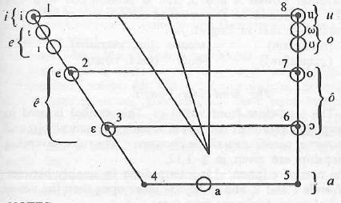
10th World Congress of African Linguistics
Leiden University June 7-12, 2021
(This version: Colloquium on African Languages and Linguistics,
HU Berlin, June 15th, 2021)
Setswana mid vowels revisited
Christfried Naumann
Humboldt-Universität zu Berlin
christfried.naumann@hu-berlin.de
Budzani Gabanamotse-Mogara
University of Botswana
mogarab@ub.ac.bw
Dipogiso Molefhi
University of Botswana
maed@ub.ac.bw
Fig.: Cole (1955: 5)

Slide 2
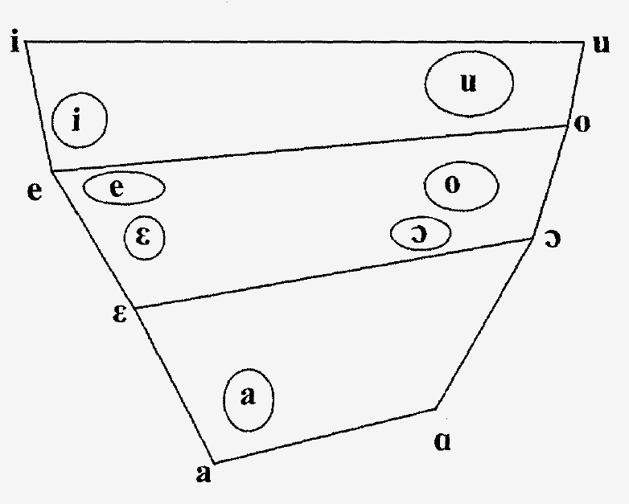
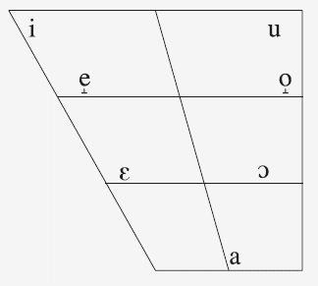
1. Introduction
The vowel system of Setswana
usually analysed as as 7-vowel system /i, e̝, ɛ, a, ɔ, o̝, u/ (Bennett et al. 2016)*
based on the phonological article by Cole (1949), arguing against 9 vowels (!)
Cole (1955: 5, adapted**):
/i/ [i] /u/ [u]
/ɪ/ [ı] /ʊ/ [ω]
[ɪ] [ʊ]
/ɛ/ [e] /ɔ/ [o]
[ɛ] [ɔ]
/a/ [a]
→ 7 orthographic symbols:
i u
e o
ê ô
a
Le Roux & Le Roux (2008: 170):
Vowel chart for the basic vowels of Setswana
Bennett et al. (2016: 242): Seven contrastive vowels
*Cf. Cole 1955, DALL 1999, Le Roux & Le Roux 2008, Otlogetswe 2017. **Phonemic representations added here.
Notes:
note: Cole (1955) does not specify the phonemic representation as /i, ɪ, ɛ, a, u, ʊ, ɔ/, but represents the phonemes directly in their orthographic reprsentation <i, e, ê, a, u, o, ô, u>. He alligns them according to "Front" , "Back" and "Close", "Semi-close", "Semi-open" and "Open". (I.e., /i, ɪ, ɛ .../ has been chosen here in consistency with what follows.)

Slide 3
1. Introduction
7-vowel analyses for Sotho-Tswana languages: e.g. Northern Sotho (Sepedi)
Louwrens et al. (1995: 4): "The vowel phonemes are /i, e, ɛ, a, ɔ, o, u/."
Compare vowels preceding /Ca#/ for one male speaker of Northern Sotho:*
*p.c. Shasha Seakamela (2016), speaker of the Hananwa variety of Northern Sotho
Notes:
The "7 vowel system" analysis of Setswana must be seen in light of similar analyses for closely-related Sotho-Tswana languages, namely Northern Sotho (and Sesotho).

Slide 4
1. Introduction
7-vowel analyses for Sotho-Tswana languages: e.g. Northern Sotho (Sepedi)
The four mid vowels /e, ɛ, o, ɔ/ have raised allophones [e̝, o̟, ɛ̝, ɔ̝]. They occur if the vowel in the following syllable is higher than the basic variant of the vowel in question (assimilation in vowel height). (Louwrens et al. 1995: 4)
cf. vowels preceding /Ci#/ and /Cu#/* :
*p.c. Shasha Seakamela (2016), speaker of the Hananwa variety of Northern Sotho. Cf. Kotzé (1989: 95f.) for possibly more complex rules of allophony in Northern Sotho than presented here.
Notes:
The "7 vowel system" analysis of Setswana must be seen in light of similar analyses for closely-related Sotho-Tswana languages, namely Northern Sotho (and Sesotho). It seems clear that the original vowel system of Sotho-Tswana has 7 vowels.

Slide 5
1. Introduction
The 7-vowel analysis applied to Setswana (Cole 1955: 7-15)
The raised allophones [ı, ω] (~ [ɪ̝, ʊ̝]) of the 'semi-close' vowels /ɪ, ʊ/ occur when followed by
  the vowels /i, u/ in the next syllable, e.g. [-lɪɸa] "pay a fine" → [mωlıɸi] "payer"
  the locative suffix –(i)ng, e.g. [mʊtʰʊ] "person" → [mωtʰωŋ] (locative of motho)
Conditioning for the raised allophones [e, o] of the 'semi-open' vowels /ɛ, ɔ/, however, is very complex. [e, o] occur when followed by
  the vowels /i, ɪ, u, ʊ/ in the next syllable, e.g. [-rɛkʼa] "buy" → [mʊrekʼi] "buyer"
  a syllabic nasal consonant /m, n, ɲ, ŋ/, e.g. [-tɬʰompʰa] "respect, honour", with very few exceptions e.g. [tʼɔntʼɔlɔ] "core of a matter, tip of a root"
  /s, ts, tsʰ, ʃ, tʃ, tʃʰ/ "if these are the products of palatalization due to the causative suffix –ya", e.g. [-tɬʼɔla] "anoint oneself" → [-tɬʼotsʼa] "anoint a person", but [‑ɔtsʼɛla] "be drowsy, doze" (underived /ts/)
  /ɛ/ is usually raised to [e] when followed by /tɬ/, e.g. [lɪχetɬʼa] "shoulder", with very few exceptions ([pʼɛtɬʼɛkɛ] "bateleur eagle") (/ɔ/ is not raised before /tɬ/)
  raised [e, o] progressively assimilates final /ɛ, ɔ/, e.g. [-betlʼa] "carve" + *-ɔ → [pʼetɬʼo] "adze"
Notes:
Similarly, the higher allophones of Setswana mid vowels ([ı, e, ω, o] in Cole 1955) are reported to be triggered by following higher vowels, but the conditioning is more complex [than what is reported for Northern Sotho by Louwrens et al.].
Note: Cole (1955: 10, 16) mentions that the allophonic rules are similar (complex) in Northern Sotho and Southern Sotho. Cf. also Kotze (1989: 95ff.) in this respect!

Slide 6
1. Introduction
The 7-vowel analysis applied to Setswana (Cole 1955: 7-15)
Occurence of the raised allophones [e, o] (continued:)
  exclusively the raised allophones occur in noun prefixes and demonstrative morphemes, e.g. [bo-] (noun class 1a), [jo], [jona], [jole] (demonstratives noun class 1), [tsʼe], or [tsʼena], [tsʼele] (demonstratives noun class 8)
  the raised allophones also occur in some miscellaneous cases, e.g.
    in the perfect suffixes [-ile] and [-itsʼe]
    in monosyllabic deficient verb stems
    in some stems with the ending [...ele], e.g. [-lelele] "long, tall"
    in the noun [kwʼena] "crocodile" (<*kwênya)
    in many interjections and some ideophones, e.g. [e:] "yes", [heela] "hey!"
  some minor rules
  words borrowed from foreign languages do not need to follow these rules, e.g. [sɪkʼolo~sɪkwʼele] "school", [boro] "drill", [sɪtʼɛmpɛ] "stamp" or [pʼɔntʼɔ] "pound"
Colesʼ summary (1955: 15f.): "... In the very vast majority of cases, [...], the two varieties are related by exact rules ... there can be no doubt whatsoever that [ɛ] and [e] together constitute a single phoneme, as also do [ɔ] and [o]."
Notes:
Similarly, the higher allophones of Setswana mid vowels ([ı, e, ω, o] in Cole 1955) are reported to be triggered by following higher vowels, but the conditioning is more complex.

Slide 7
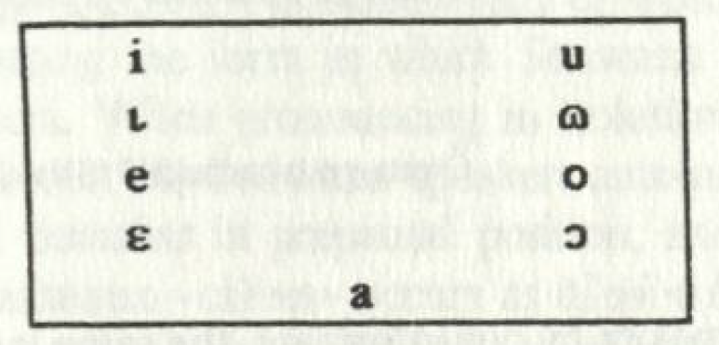
1. Introduction
The 7-vowel analysis applied to Setswana: Critique
Chebanne et al. (1997: 11), however, argue:
"A closer examination of the data provided by Cole himself shows that this analysis has certainly been influenced by diachronic considerations. Every phonologist, applying consistently to such data the distributional method for establishing the phonemes of Setswana, would conclude that Setswana has nine vowel phonemes. In fact, no complementary distribution can be shown to exist between e and ɛ or between o and ɔ. ... [N]ear-minimal pairs like the following ones clearly show that no general phonological conditioning can explain the choice between mid- and semi-open vowels in Setswana, the only possible conclusion being that they do constitute distinct phonemes: ..."
→ Chebanne et al. (1997: 11) and Creissels (1999: 311, 2003: 33, etc.),
in agreement with Jones & Plaatjie (1916: xiv) and Jones (1967: 45)*,
postulate 9 vowels displaying 5 degrees of aperture for Setswana:
*Cf. Dichabe (1997: 51, 57).
Notes:
Chebanne et al. thereby agree with the analysis of Setswana vowels by the renowned British phonetician Daniel Jones who had worked intensively with the Setswana-speaking intellectual Sol Plaatjie (cf. Jones 1967: 45 "... the vowels i, ı, e, ɛ and a, ... the remaining vowels ɔ, o, ɷ and u...")
CHECK Jones & Plaatjie !!!

Slide 8
1. Introduction
Distinctive/contrastive sounds (phonemes)
"... segments that are known to distinguish lexical items within a language." (Ladefoged & Maddieson 1996: 2, in The Sounds of the Worldsʼ Languagues)
"...distinctive sound ... [a] sound which, being used instead of another, in the same language, can change the meaning of a word. This notion of a 'distinctive sound' is what became widely known in the twentieth century as the phoneme." (IPA 1999: 27)
"Phonemes contrast with each other: a difference between a phoneme pair, embedded in otherwise identical contexts, normally has the potential to convey a meaning difference." (Steriade 2007: 139, in Contrast)
"Predictable variants are termed allophones – the sounds are in complementary distribution because the context where one variant appears is the complement of the context where the other sound appears." (Odden 2005: 44, in Introducing Phonology)
"... a phoneme is a family of sounds in a given language which are related in character and are used in such a way that no one member ever occurs in a word in the same phonetic context as any other member.", "'In the same phonetic context' means 'when surrounded by the same sounds and subject to the same conditions as regards duration, stress and voice pitch.'" (Jones 1967: 10, 9, in The phoneme)
→ = sounds contrasting with each other in the same context (same surrounding sounds, same conditions of stress and tone) that may be used to distinguish words and morphemes of different meanings
Notes:
In this discussion, we first need to specify what is generally meant by ʼphoneme' or 'distinctive or contrastive' sound.

Slide 9
1. Introduction
Distinctive/contrastive sounds (phonemes)
These definitions do not differentiate between different grammatical or etymological categories of words. Textbook examples for the phonemes of English frequently take recourse to words of
  different origin (borrowings vs. inherited lexicon)
  beige vs. bathe (Gordon 2019: 61, frequently [beɪʒ] vs. [beið])
  different parts of speech/word classes
  hiss vs. his (Burquest 2006: 35, verb vs. pronoun)
  had vs. hat (Odden 2005: 44, auxiliary verb vs. noun)
  Dick vs. tick (Odden 2005: 44, proper name vs. verb/noun)
→ Distinctive sounds (phonemes) must be determined by phonological criteria.
→ A differentiation of allophones based on morphological criteria (e.g. in pronouns or implying causative constructions) or historical considerations (e.g. excluding [inte-grated] borrowings) is not valid and does not conform with current procedures.
→ Cole's conditions for raised 'allophones' of mid vowels are largely inappropriate.
Notes:
Thus, textbook examples for the discussion of the phonemes of English often take recourse to words of ...

Slide 10
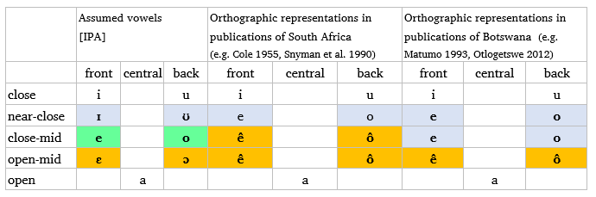
1. Introduction
The 7-vowel analysis applied to Setswana: Critique
By comparison of the standard orthographies used in Botswana and South Africa, 9 categories of vowels can be distinguished.
Still, most recent publications (e.g. DALL 1999, Otlogetswe 2017) and even dedicated phonetic-phonological studies (e.g. Tlale 2005, Le Roux & Le Roux 2008, Bennett et al. 2016) follow Cole's argument of a 7-vowel analysis (1949, 1955).
Notes:
^ - circumflex
9 categories: There are 7 vowels unanimoulsy represented as /i, e, ê, a, u, o, ô/ plus 2 categories of vowels represented as /ê, ô/ in South African publications and as /e, o/ in publications in the standard orthography of Botswana.

Slide 11
1. Introduction
This study
pleading for the (re-)adoption of the 9-vowel analysis based on
  acoustic data from 9 speakers of central dialects of Setswana (SE Botswana)
  general phonological reasoning
in the framework of
  functional linguistics
  basic phonology (linguistic phonetics, IPA)
  exploratory data analysis in Laboratory Phonology
Hypothesis: There are nine contrastive vowels /i, ɪ, e, ɛ, a, u, ʊ, o, ɔ/.
(The vowels transcribed as <ı ɷ>in Chebanne et al. 1997 and Creissels 1999, 2003 are represented here as <ɪ ʊ>, respectively.)
Assumption: Categories of sounds are can be characterised acoustically by essential properties (vowels: F1, F2, F3 in time). Distinct categories differ in at least one feature consistently, where tokens of one category fall repeatedly into one cloud of data points and tokens of the other category fall into another cloud of data points, without significant overlaps in the distribution.
Notes:
- "mid vowels" used as cover term for non-close and non-open vowels, i.e. near-close, close-mid and open-mid vowels (usually represented in written Setswana as <e, o>)

Slide 12
2. Acoustic study
Procedure
audio recordings of words in isolation including different vowels in 4 broad contexts
  /__.C__#: vowels in high- and low-toned (stressed) penultimate syllables followed by vowels of the same quality, e.g. lefifi [lɪ̀fìːfì]* "darkness" or pele [pɪ́ːlɪ̀] "first" (25 words)
  /__.Ca#: vowels in high- and low-toned (stressed) penultimate syllables followed by /a/, e.g. (go) bitsa [(χʊ̀)bíːtsà] "(to) call" or (go) besa [(χʊ̀)bèːsà] "(to) roast" (49 words)
  /__.C{i,u}#: vowels in high- and low-toned (stressed) penultimate syllables followed by the closed vowels /i, u/, e.g. bohibidu [bʊ̀híbíːdù] "red colour" (28 words)
  /C__(.__)#: vowels in high- and low-toned monosyllabic words (CV) and words with a sequence of two identical vowels (CV_{i}V_{i}), e.g. tsi! [tsí] (interjection) or tsaa [tsáà] "take!" (26 words; largely excluded from acoustic analysis)
  5. miscellaneous pairs of words (53 words, largely excluded from acoustic analysis)
  following consonants (C) preferably non-nasal, non-rhotic coronal-alveolar [t, tʰ, l, d, s, ts, tsʰ], some others, mainly [n, r, f, m, k]
  tried to avoid the adjacency of laterally released, palatal and uvular consonants (e.g. [tɬ, ʃ, ɲ, χ])
*Tones are represented as found in words in isolation, i.e. as in the recorded word forms.

Slide 13
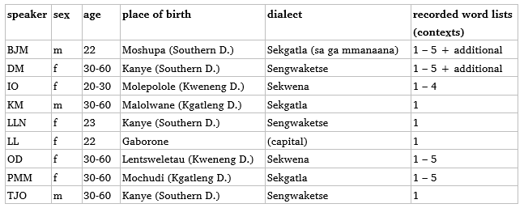
2. Acoustic study
Procedure
context 1 recorded with 9 adult mother-tongue speakers of Setswana from various places of birth in southeastern Botswana (Greater Gaborone area), 3 to 6 tokens
contexts 2 – 5 recorded with 4 to 5 speakers, 3 tokens of each word
additional post hoc recordings with 2 speakers

Slide 14
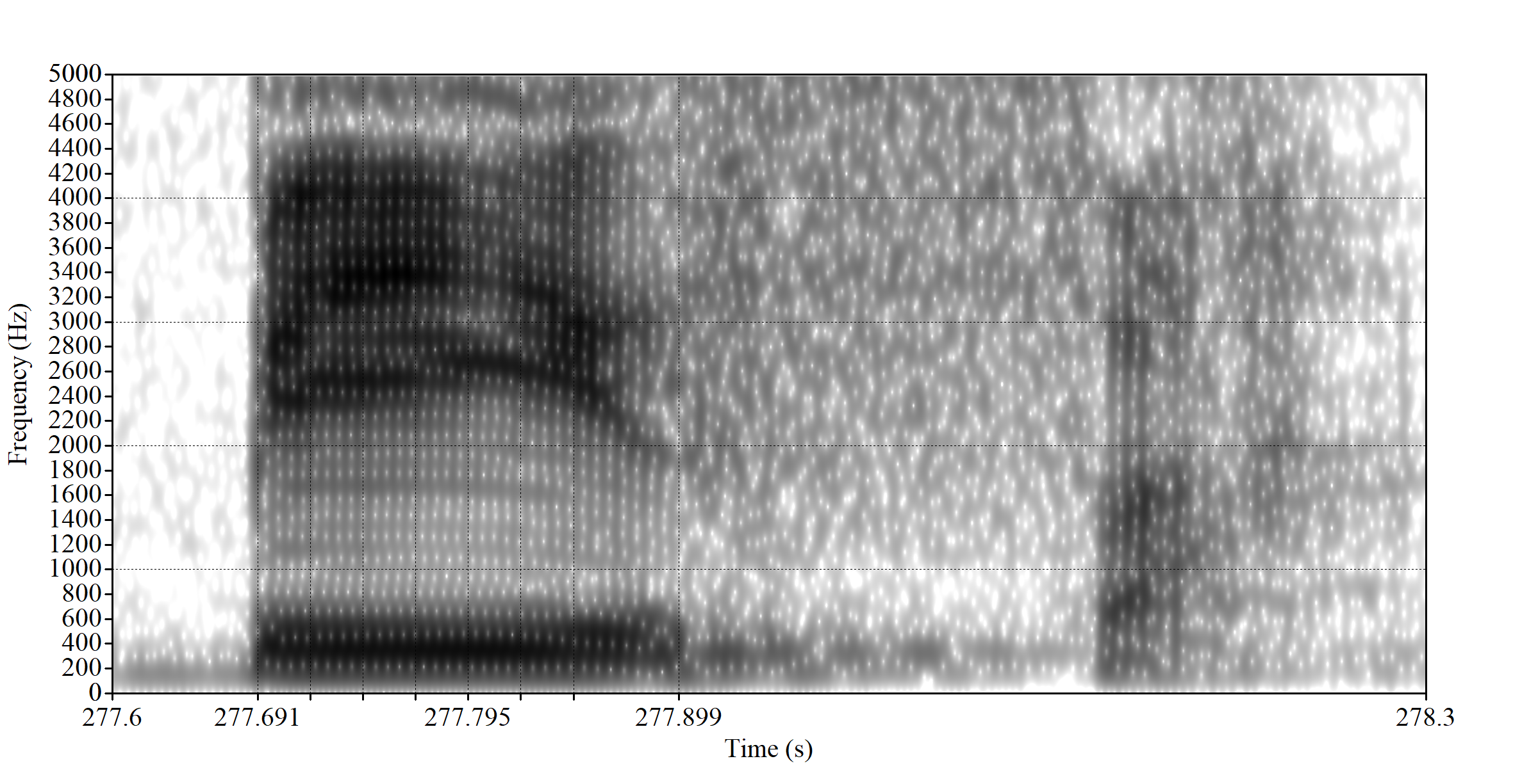

2. Acoustic study
Procedure
formant analysis in Praat (Boersma & Weenink 2021): 3 formants (F1, F2, F3) measured at 0.125, 0.25, 0.375, 0.5, 0.625 and 0.75 of vowel length
[ 'b èː s à ]
0.125 0.25 0.375 0.5 0.625 0.75
F1 376 Hz 362 Hz 352 Hz 344 Hz 344 Hz 380 Hz
F2 2458 Hz 2528 Hz 2587 Hz 2649 Hz 2628 Hz 2544 Hz
F3 3202 Hz 3356 Hz 3394 Hz 3449 Hz 3298 Hz 3047 Hz
F3
F2
F1
0.125
0.375
0.625
0.25
F1 – correlated to vowel height (close/open)
F2 (+F3) – correlated to tongue position
vowel
onset
0.25
0.5
0.75
end of
vowel
Example articulated by speaker IO.
Notes:
formant settings? (cf. Data sheet), automatic (script-based)
example from female speaker IO

Slide 15
2. Acoustic study
Procedure
values of F1, F2 (and F3) at 0.5 of vowel length plotted in Excel charts
data point of [e]
(344 Hz; 2649 Hz)
Notes:
F1/F2 corresponding to vowel Trapez

Slide 16
2. Acoustic study
Procedure
trajectories (contours) of F1 and F2

Slide 17
2. Acoustic study
1. /__.C__#: vowels in penultimate syllables followed by an identical vowel
e.g. for speaker TJO (in total: 20 words, 3 tokens each)
ex.1 vowel ex.2 vowel
[i] mmidi [m̀.'míː.dì]* "maize"
lefifi [lɪ̀.'fìː.fì] "darkness"
[ɪ] sefe ['sɪ́(ː).fɪ̀] "which" (7)
se sele [sɪ́.'sɪ̀ː.lɪ́] "a different one" (7)
[e] sele ['séː.lè] "that one" (7)
Setebele [sɪ̀.tè.bèː.lè] "Ndebele language"
[ɛ] sêlê ['sɛ́ː.lɛ̀] "cell, cellphone"
ênê ['ʔɛ̀ː.nɛ́] "s/he" (pronoun 1)
[a] go sala [χʊ̀.'sáː.là] "to stay"
go alafa [χʊ̀.à.'làː.fà] "to treat"
[u] makuku [mà.'kúː.kù] "very early morning"
khudu ['kʰúː.dù] "tortoise"
[ʊ] koko ['kʊ́ː.kʊ̀] "chicken"
bolo ['bʊ́ː.lʊ̀] "ball"
[o] koko! ['kóː.kò] "knock-knock!" (interjection)
sekolo [sɪ̀.'kóː.lò] "school"
[ɔ] lekôkô [lɪ̀.'kɔ́ː.kɔ̀] "group (of people)"
thôlô ['tʰɔ̀ː.lɔ́] "kudu (antelope)"
*High tones preceding a low tone are realised as falling tones [ ̂].

Slide 18
2. Acoustic study
1. /__.C__#: vowels in penultimate syllables followed by an identical vowel
speaker TJO, scatter plot F1×F2 (×F3): distributional overlaps i - ɪ, ɪ - e, and o - ɔ
Notes:
but: if vowels in high-toned syllabels vs. low-toned syllables are differentiated, the contrast becomes evident

Slide 19
2. Acoustic study
1. /__.C__#: vowels in penultimate syllables followed by an identical vowel
speaker TJO: no overlaps for F1 trajectories of high-toned front vowels (i : ɪ, ɪ : e, e : ɛ)

Slide 20
2. Acoustic study
1. /__.C__#: vowels in penultimate syllables followed by an identical vowel
speaker DM: similar F1 trajectories of high-toned front vowels (i : ɪ, ɪ : e, e : ɛ)

Slide 21
2. Acoustic study
1. /__.C__#: vowels in penultimate syllables followed by an identical vowel
speaker TJO: no overlaps for F1 trajectories of high-toned back vowels (u : ʊ, ʊ : o, o : ɔ)
Notes:
in near minimal pairs !

Slide 22
2. Acoustic study
1. /__.C__#: vowels in penultimate syllables followed by an identical vowel
speaker KM: F1 trajectories of high-toned back vowels (u : ʊ, ʊ : o, o : ɔ) with 6 tokens each

Slide 23
2. Acoustic study
1. /__.C__#: vowels in penultimate syllables followed by an identical vowel
speaker KM: F2 trajectories are more important for the distinction ʊ : o

Slide 24
2. Acoustic study
1. /__.C__#: vowels in penultimate syllables followed by an identical vowel
speaker OD, scatter plot F1×F2 (×F3): 9 different clouds of data points

Slide 25
2. Acoustic study
1. /__.C__#: vowels in penultimate syllables followed by an identical vowel
For one speaker (PMM), there are strong overlaps between adjacent vowels
Notes:
The speaker didnʼt feel comfortable in the beginning of the recording. (what she later confirmed).

Slide 26
2. Acoustic study
1. /__.C__#: vowels in penultimate syllables followed by an identical vowel
speaker PMM: F1 trajectories of low-toned back vowels (ʊ : o : ɔ) with 3 tokens each
"minute" "bonus, profit" "mistake"

Slide 27
2. Acoustic study
1. /__.C__#: vowels in penultimate syllables followed by an identical vowel
speaker LLN: no tokens of [ɪ] in this context due to different final vowel ([sɪ̀:lɛ̀, sɪ́:fɛ])
Notes:
A difference was not found between

Slide 28
2. Acoustic study
1. /__.C__#: vowels in penultimate syllables followed by an identical vowel
speaker IO: no difference for assumed [ɪ] – [e] was detected
Notes:
A difference was not found between

Slide 29
2. Acoustic study
1. /__.C__#: vowels in penultimate syllables followed by an identical vowel
For one speaker (IO), no acoustic difference for assumed [ɪ] – [e] can be shown
*Note the final voiceless vowel in [sɪ̀.tè.bè.le̥].
Notes:
A difference was not found between

Slide 30
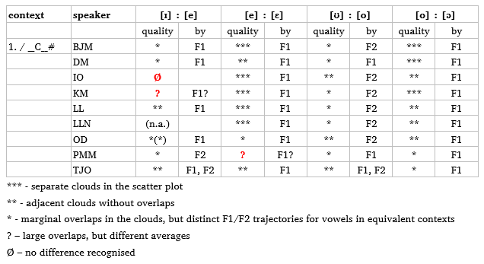
2. Acoustic study
1. /__.C__#: vowels in penultimate syllables followed by an identical vowel
Distinctness of mid vowels
  [ɪ] : [e] (clearly) existent for (3 –) 6 speakers; apparently absent for 1 speaker
  other distinctions (e : ɛ, ʊ : o, o : ɔ) well supported (1 ambiguous case)
  F2 decisive for [ʊ] : [o]

Slide 31
2. Acoustic study
2. /__.Ca#: vowels in penultimate syllables followed by final /a/
e.g. for speaker DM (in total: 52 words, 3 tokens each)
ex.1 vowel ex.2 vowel
[i] (go) bitsa ['bíː.tsà] "(to) call"
[ɪ] (go) beta ['bɪ́:.tà] "(to) choke"
[e] (go) fetsa ['fé:.tsà] "(to) finish"
[ɛ] p(o)rôfêsa [p(ʊ̀.)rɔ̀.'fɛ́:.sà] "professor"
[a] pata ['pá:.tà] "road"
[u] (go) busa ['bú:.sà] "(to) return"
[ʊ] (go) botsa ['bʊ́ː.tsà] "(to) ask"
lona ['lʊ̀:.ná] "you (PL)"
[o] (go) gotsa ['χó:.tsà] "(to) make fire"
lona ['ló:.nà] "this" (11)
[ɔ] (go) fôsa* ['fɔ́:.sà] "(to) force"
(go) bôna ['bɔ́ː.nà] "(to) see"
* (go) fôsa is a recent anglicism (to force) that may not be acknowledged as a Setswana word by speakers.

Slide 32
2. Acoustic study
2. /__.Ca#: vowels in penultimate syllables followed by final /a/
speaker DM, scatter plot F1×F2 (×F3): distributional overlaps ɪ - e, ʊ - o, o - ɔ
Notes:
but: if vowels in high-toned syllabels vs. low-toned syllables are differentiated, the contrast becomes evident

Slide 33
2. Acoustic study
2. /__.Ca#: vowels in penultimate syllables followed by final /a/
similar: scatter plot F1×F2 (×F3) for speaker BJM of vowels in high-toned syllables
Notes:
but: if vowels in high-toned syllabels vs. low-toned syllables are differentiated, the contrast becomes evident

Slide 34
2. Acoustic study
2. /__.Ca#: vowels in penultimate syllables followed by final /a/
speaker DM: no overlaps for F1 trajectories of high-toned front vowels (i : ɪ, ɪ : e, e : ɛ)

Slide 35
2. Acoustic study
2. /__.Ca#: vowels in penultimate syllables followed by final /a/
similar: speaker BJM

Slide 36
2. Acoustic study
2. /__.Ca#: vowels in penultimate syllables followed by final /a/
different: speaker IO, with possible merger of ɪ and e

Slide 37
2. Acoustic study
2. /__.Ca#: vowels in penultimate syllables followed by final /a/
speaker DM: no overlaps for F1 trajectories of high-toned back vowels (u : ʊ, ʊ : o, o : ɔ); here: distinction u : ʊ and ʊ : o mainly by F1 contour of ʊ

Slide 38
2. Acoustic study
2. /__.Ca#: vowels in penultimate syllables followed by final /a/
speaker OD: no overlaps for F1 trajectories of high-toned back vowels (u : ʊ, ʊ : o, o : ɔ)

Slide 39
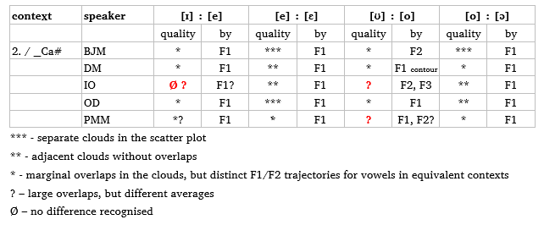
2. Acoustic study
2. /__.Ca#: vowels in penultimate syllables followed by final /a/
Distinctness of mid vowels
  distinctions [ɪ] : [e] and [ʊ] : [o] existent for 3 (/5) speakers
  [ɪ]~[e] merged for 1 speaker ?
  clear contrasts between close-mid and open-mid vowels ([e] : [ɛ], [o] : [ɔ])
  contrastive F2 values for [ʊ] : [o] for one speaker

Slide 40
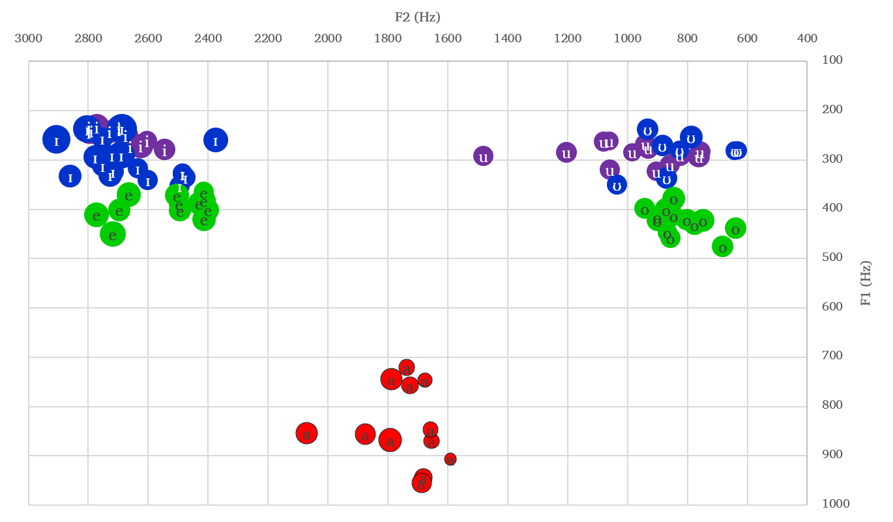
2. Acoustic study
3. /__.C{i,u}#: vowels in penultimate syllables followed by final /i, u/
no open-mid vowels in this context: phonological raising to close-mid vowels
[e] and [o] are similar to other contexts, while [a], [ɪ] and [ʊ] are higher > [ɪ] and [ʊ] similar to [i] and [u], respectively (Coleʼs [ı, ω], slide 5)
e.g. for speaker OD:
Notes:
distinctiveness [ɪ, ʊ] : [e, o] better, [ɪ, ʊ] : [i, u] worse (not thoroughly analysed in this study)

Slide 41
2. Acoustic study
3. /__.C{i,u}#: vowels in penultimate syllables followed by final /i, u/
speaker BJM: also i seems to be raised [i̝], distinction to [ɪ̝] is maintained

Slide 42
2. Acoustic study
4. /C__#: vowels in monosyllabic words (CV)
words (CV_{i}V_{i}) discarded from analysis (divergent patterns from CV)
analysis of CV words and morphemes restricted to one speaker (BJM)
  many items = ideophones and interjections displaying considerable inter-speaker variation > reduced transparency of phonological forms
speaker BJM (in total: 18 words/morphemes, 3 to 6 tokens each)
[i] di [dí] (subject marker 8)
tsi! [tsí] ideo. "stopped entirely"
[ɪ] le [lɪ́] (subject marker 5)
ke [kɪ́] (identificational marker)
[e] se [sé] (basic demonstrative 7)
tse [tsé] (basic demonstrative 8)
[ɛ] tsê! [tsɛ́] ideo. "sting!" (insect)
[a] a [á] (basic demonstrative 6)
ba [bá] (basic demonstrative 2)
[u] tshu! [tsʰú(:)] interj. "hot!"
phu!* [pʰú] ideo. "boom!"
[ʊ] bo [bʊ́] (subject marker 14)
po* [pʊ́] ideo. "falling down"
[o] bo [bó] (basic demonstrative 14)
lo [ló] (basic demonstrative 11)
[ɔ] pô [pɔ́] ideo. "hitting"
*In dictionaries found as <pho> and <poo>.

Slide 43
2. Acoustic study
4. /C__#: vowels in monosyllabic words (CV)
speaker BJM

Slide 44
2. Acoustic study
4. /C__#: vowels in monosyllabic words (CV)
speaker BJM: distinct trajectories [ɪ] : [e] and [ʊ] : [o] in the second half

Slide 45
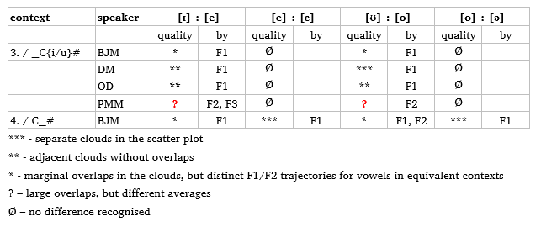
2. Acoustic study
3. /__.C{i,u}# and 4. /C__#: Distinctness of mid vowels
Context 3
  no open-mid vowels – merged with close-mid vowels (as expected)
  most remaining vowels are raised – near-close vowels more similar to close vowels
  distinctions [ɪ] : [e] and [ʊ] : [o] existent for 3 (/4) speakers
Context 4
  difficult to study due to paucity of lexical items stable in their phonological form
  speaker BJM: all assumed distinctions supported

Slide 46
3. Discussion
Summary of the acoustic study
existence of 9 distinct categories of vowels in the contexts 1, 2 and 4:
  9 positive cases
  4 ambiguous cases
  2 negative cases by one speaker (speaker IO for [ɪ] ≈ [e] > possible merger)
all speakers distinguish [ʊ] : [o] at least in one context (context 1)
near-close and close-mid vowels (ɪ - e ; ʊ - o) more similar to another (more difficult to distinguish by non-native speakers) than the latter to open-mid vowels
F2 important especially for [ʊ] : [o] (for most speakers in at least some contexts)
  → distinction of 9 vowels not simply a matter of 5 degrees of aperture or vowel height, but place of constriction plays some role (tongue position/root, tense/lax?, protrusion of the lower jaw?)
  → potential support for claim of advanced tongue root harmony (Dichabe 1997)
general confirmation of the phonetic description of vowel allophones by Cole (1949, 1955) except for the plain claim of "11 vowel phones" (Cole 1955: 4-5)
no confirmation of a relatively low (open) articulation of /i/ (Le Roux & Le Roux 2008), but cases of extremely high realisations

Slide 47
3. Discussion
Contrast in identical or similar environments
/ɪ/:/e/
le (subject marker 5) le (basic demonstrative 5)
[lɪ́] [lé]
se (subject marker 7) se (basic demonstrative 7)
[sɪ́] [sé]
di a tsena " it [fruit] is going bad" bona tsena "see these ones"
[dí.á.tsɪ́:.nà] [bó.nà.tsé:.nà]
ga ba tile "they donʼt avoid" ba badile "they have read"*
[χà.bá.tí:.lɪ̀] [bá.bá.dí:.lè]
pênê e tona "the pen is big" pênê e tona "the big pen"
[pɛ́nɛ́.ʔɪ́.tʊ́:.nà] [pɛ́nɛ̀.ʔé.tʊ́:.nà]
(cf. abstract syllables read by BJM:)
[bɪ:] - [be:]
[lɪ:] - [le:]
[sɪ:] - [se:]
Cf. Burquest (2006: 35). Word pairs articulated by OD, BJM, DM, BJM. *Note the friction on [í:].

Slide 48
3. Discussion
Contrast in identical or similar environments
/e/:/ɛ/
(sekolo) sele "that (school)" (7) sêlê "cell, cellphone"
[(sɪ̀.kó.lò) sé:.lè] [sɛ́:.lɛ̀]
tsena "these ones" (8) tsêna "enter!"
[tsé:.nà] [tsɛ́:.nà]
tse (basic demonstrative 8) tsê "sting!" (insect)
[tsé] [tsɛ́]
kwena "crocodile" wêna "you"
[kwè:.nà] [wɛ̀:.ná]
ena "this one" (9) êma "stop!"
[ʔé:.nà] [ʔɛ́:.mà]
(cf. abstract syllables read by BJM:)
[be:]- [bɛ:]
[le:] - [lɛ:]
[se:] - [sɛ:]
Word pairs articulated by speakers LLN, PMM, OD, DM, BJM.

Slide 49
3. Discussion
Contrast in identical or similar environments
/ʊ/:/o/
o (subject marker 1) o (basic demonstrative 3)
[ʔʊ́] [ʔó]
koko "chicken" koko! "knock-knock!" (interj.)
[kʊ́:.kʊ̀] [kó:.kò]
bonya "slowness" bonya! "blink (your eyes)!"
[bʊ̀:.ɲà] [bò:.ɲá]
tlotlile "has respected" tlotlile "has chatted"
[tɬʊ̀.tɬì:.lè] [tɬò.tɬì:.lè]
(cf. abstract syllables read by BJM:)
[bʊ:]- [bo:]
[lʊ:] - [lo:]
[sʊ:] - [so:]
Word pairs articulated by speakers BJM, TJO, DM, PMM

Slide 50
3. Discussion
Contrast in identical or similar environments
/o/:/ɔ/
koko! "knock-knock!" (interj.) lekôkô "group of people"
[kó:.kò] [lɪ̀.kɔ́:.kɔ̀]
bona "this one" (14, variant) bôna! "see!"
[bó:.nà] [bɔ́:.nà]
bo (basic demonstrative 14, variant) pô! ideo. "hitting"
[bó] [pɔ́]
seporo "trail" mokôrô "boat"
[sɪ̀.pó:.rò] [mʊ̀.kɔ́:.rɔ̀]
(cf. abstract syllables read by BJM:)
[bo:]- [bɔ:]
[lo:] - [lɔ:]
[so:] - [sɔ:]
Word pairs articulated by speakers BJM, OD, BJM, LL.

Slide 51
3. Discussion
Caveats to the assertion of 9 distinctive vowels in (central) Setswana
The relatively high predictability of close-mid vowels is evidence for their development out of former allophones of open-mid vowels. → It is clear that the 9-vowel system has evolved from a former 7-vowel system.
The functional load of close-mid vowels is limited, such that future vowel changes leading to a new 7-vowel system (with a potential merger of close-mid and near-close vowels) might take place at a low cost of rearrangement.
The system seems not to be fully stable. For a substantial number of recorded lexical items, variants across categories of mid vowels were observed, e.g.
  Main form (expected and repeatedly found) Variants observed
sefe "which" (7) [sɪ́.fɪ̀] [sɪ́.fɛ̀]
se sele "different one" (7) [sɪ́.sɪ̀:.lɪ́] [sɪ́.sɪ̀:.lɛ̀]
šena "bare the teeth!" [ʃɪ̀:.ná] [ʃɛ̀:.ná]
bolo "ball" [bʊ́:.lʊ̀] [bɔ́:.lɔ̀]
koko "knock-knock!" [kó:.kò] [kɔ́kò], [kɔ́.kɔ̀ɔ́], [kɔ́.kɔ̀]
seporo "trail" [sɪ̀.pó:.rò] [sɪ̀.pɔ́:.rɔ̀]
mokôrô "boat" [mʊ̀.kɔ́:.rɔ̀] [mʊ̀.kó:.rò]
The inter-speaker variation such as between [e] and [ɛ] in a number of lexical items does not mean that these sounds are allophones (cf. also sa je [sà:.dʒé] ~ sa jê [sà:.dʒɛ́] "donʼt eat!"). They are comparable to English either [ˈi:.ðər] ~ [ˈaɪ.ðər] or ask [æsk] ~ [ɑsk] where the respective vowels belong to different phonemes (as instances of lexical variation).
Word pairs: speakers LL – LLN, OD – LLN, OD – PMM, OD – IO, BJM – DM/LLN/OD, BJM – KM, BJM – BJM
Notes:
Most near and minimal pairs depend on/include demonstratives, borrowings and interjections/ideophones

Slide 52
3. Discussion
Conclusions
Based on the acoustic analysis in different phonological environments and the contrasts found in near minimal pairs and minimal pairs, we conclude that there are nine contrastive vowels /i, ɪ, e, ɛ, a, u, ʊ, o, ɔ/ in Setswana (central Setswana, for 8 out of 9 speakers investigated).
The differentiation of 9 vowels – rare in Bantu languages- is supported by distinct categories of sounds characterised by properties in the acoustic space where tokens of one category are more similar to each other than to tokens of other categories, without significant overlaps. They differ in at least one feature.
Near-close and close-mid vowels are similar to each other – and potentially difficult to distin-guish (L2 speakers). It cannot be excluded that a process of neutralisation (merger) has started for [ɪ] – [e] (some speakers). Close-mid vowels and open-mid vowels are acoustically distinct.
Near minimal pairs and minimal pairs for the contrast between mid vowels largely depend on interjections and ideophones, borrowings and demonstratives.
The Setswana vowel system is not simply based on 5 degrees of height but involves adjustments of tongue (root?) position. It might represent a case of incipient tongue root harmony (cf. Dichabe 1997).
Two interesting phonetic phenomena were occasionally observed: friction accompanying /i/ (e.g. on p.47) and final voiceless vowels (e.g. on p.29).
The importance of equivalent tone patterns for the prove of contrastive vowels had been underestimated in the preparation of this study. (For acoustic distinctness, tone appeared to be more important than coarticulatory effects of adjacent consonants. > Look for vowel contrasts under identical conditions of tone!)
One less expected, problematic property of interjections and ideophones – included here for supposed contrast based on dictionary entries – was their considerable degree of inter-speaker variation (in addition to the possible occurence of exceptional sound patterns and paralinguistic sounds).
Notes:
9 Vowels rare/exceptional for Bantu (cf. Maddieson 2003: 15-23), as ATR systems
Maddieson, Ian. 2003. The sounds of the Bantu languages. In Derek Nurse & Gérard Philippson (eds.), The Bantu Languages (Routledge Language Family Series), 15–41. London: Routledge.

Slide 53
3. Discussion
Suggestion for the representation of 9 vowels in didactic contexts
should be fully compatible with the normal orthography > by optional and omissible diacritics
in addition to the optional marking of tone
Phonemic (IPA):
/i/ /u/
/ɪ/ /ʊ/
/e/ /o/
/ɛ/ /ɔ/
/a/
+tones:
/í, ì, ɪ́, ɪ̀, é, è, ɛ́, ɛ̀, á, à, ú, ù, ʊ́, ʊ̀, ó, ò, ɔ́, ɔ̀/
Standard orthography (BW):
i u
e o
e o
ê (~e) ô (~o)
a
(no tone marking)
Didactic contexts (if useful):
i u
e o
ẹ ọ
ê ô
a
+marking high tones:
í, i, é, e, ẹ́, ẹ, ế, ê, á, a,
ú, u, ó, o, ọ́, ọ, ố, ô
Example
Lɪ́bɛ́lɛ́lá dìtsʰwáńtsʰɔ̀ tsé dílátɛ́làŋ́.
"Watch the following pictures."
Lebêlêla ditshwantshô tse di latelang. ~
Lebelela ditshwantsho tse di latelang.
Lébếlếlá ditshwáńtshô tsẹ́ dí látếlańg.
Notes:
must be compatible with the usual standard orthography (- only additional, omissible diacritics, no alternative signs; same word division as usual)
checked with Boago Majafe: dìtsʰwáńtsʰɔ̀ tsé ... (and not: *dìtsʰwáńtsʰò tsé , as it would be as a demonstrative "these pictures") ✓

Slide 54
References
Bennett, Wm G., Maxine Diemer, Justine Kerford, Tracy Probert & Tsholofelo Wesi. 2016. Setswana (South African). Journal of the International Phonetic Association 46(2). 235–246.
Boersma, Paul & David Weenink. 2021. Praat: Doing Phonetics by Computer [Computer program]. http://www.fon.hum.uva.nl/praat/.
Burquest, Donald A. 2006. Phonological Analysis: A Functional Approach. 3rd edn. Dallas, TX: SIL.
Chebanne, Andy M., Denis Creissels & H. W. Nkhwa. 1997. Tonal Morphology of the Setswana Verb. Munich: Lincom.
Cole, Desmond T. 1949. Notes on the phonological relationships of Tswana vowels. African Studies 8(3). 109–131.
Cole, Desmond T. 1955. An Introduction to Tswana Grammar. Cape Town: Longman.
Creissels, Denis. 1999. Remarks on the sound correspondences between Proto-Bantu and Tswana (S.31). In Jean-Marie Hombert & Larry M. Hyman (eds.), Bantu Historical Linguistics: Theoretical and Empirical Perspectives, 297–334. Stanford, CA: CSLI.
Creissels, Denis. 2003. Présentation du tswana. Lalies: Actes des sessions de linguistiques et de littérature 23. 5–128.
DALL (Department of African Languages and Literature, University of Botswana). 1999. The Sound System of Setswana. Gaborone: Lightbooks.
Dichabe, Seipati Bernice. 1997. Advanced tongue root harmony in Setswana. University of Ottawa M.A. thesis.
Gordon, Matthew. 2019. Phonology: Organization of Speech Sounds. In Carol Genetti (ed.), How languages work, 55–78. Cambridge: CUP.
IPA (International Phonetic Association). 1999. Handbook of the International Phonetic Association. Cambridge: CUP.
Jones, Daniel. 1967. The Phoneme: Its Nature and Use. Cambridge: Cambridge University Press.
Jones, Daniel & Solomon Tshekisho Plaatje. 1916. A Sechuana reader in international orthography (with English translations). London: University of London Press.
Kotzé, A. E. 1989. An introduction to Northern Sotho phonetics and phonology. Constantia Cape: Marius Lubbe.
Le Roux, Maria & Jurie Le Roux. 2008. An acoustic assessment of Setswana vowels. South African journal of African languages 28(2). 156–171.
Matumo, Zacharia I. 1993. Setswana-English-Setswana Dictionary. 4th edn. Gaborone: Gaborone: Macmillan Botswana.
Odden, David. 2005. Introducing Phonology. Cambridge: Cambridge University Press.
Otlogetswe, Thapelo J. 2012. Tlhalosi ya medi ya Setswana. Gaborone: Medi.
Otlogetswe, Thapelo J. 2017. Setswana Syllable Structure and Distribution. Nordic Journal of African Studies 26(4). 403–430.
Snyman, J.W., Shole J. Shole & J. C. Le Roux (eds.). 1990. Setswana English Afrikaans Dictionary - Dikišinare ya Setswana-English-Afrikaans. Pretoria: Via Africa.
Steriade, Donca. 2007. Contrast. In Paul De Lacy (ed.), The Cambridge Handbook of Phonology, 139–157. Cambridge: CUP.
Tlale, One. 2005. The Phonetics and Phonology of Sengwato, a Dialect of Setswana. Washington, D.C.: Georgetown University PhD dissertation.

Slide 55
Acknowledgements
Re a leboga – Thank you!
Mr. Boago Joseph Majafe
Ms. Dinah K. Itumeleng
Prof. Herman Batibo
Ms. Ikanyeng Obatleng
Mr. Kaone Masile
Ms. Leruo Lisa Nkhwa
Ms. Lisa Lesetedi
Ms. Oitiretse Dikhudu
Ms. Penny M. Moloi
Prof. Thapelo J. Otlogetswe

